Slide 1
EarthInsights: Parallel Clustering of Large
Earth Science Datasets on the Summit Supercomputer
Sarat Sreepathi¹, Jitendra Kumar¹, Forrest M. Hoffman¹,
Richard T. Mills², Vamsi Sripathi³, William W. Hargrove⁴
¹Oak Ridge National Laboratory
²Argonne National Laboratory
³Intel Corporation
⁴USDA Forest Service
1st Workshop on Leveraging Artificial Intelligence (AI) in the Exploitation of Satellite Earth Observations & Numerical Weather Prediction(NWP)
NOAA, College Station, MD
April 23-25, 2019

Slide 2
Motivation
Rapid proliferation of data
Earth Science
  Advanced sensors – high fidelity data
  Remote Sensing Platforms
    Satellites
    Unmanned Aircraft Systems (UAS)
    Airborne systems
  Observational Facilities
Critical need for High Performance Big Data Analytics

Slide 3
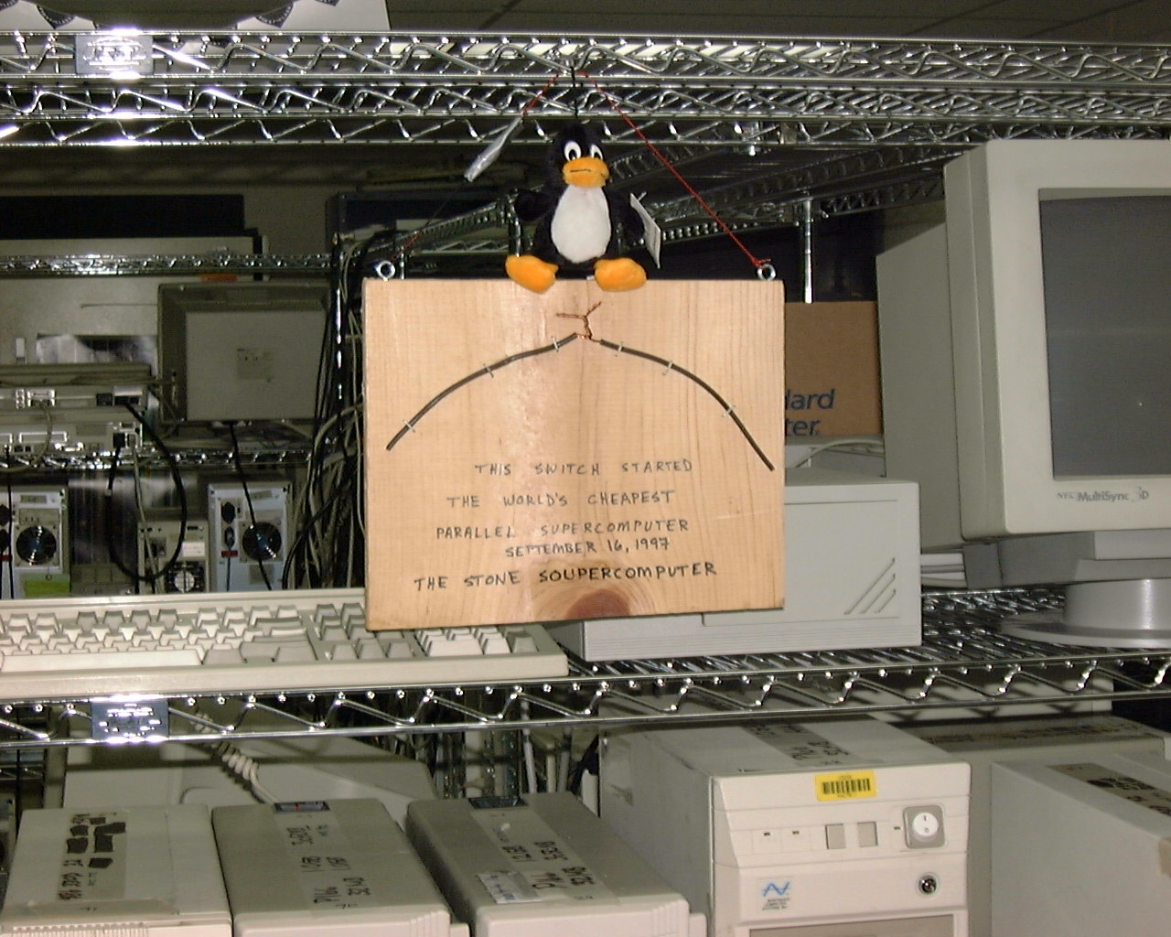
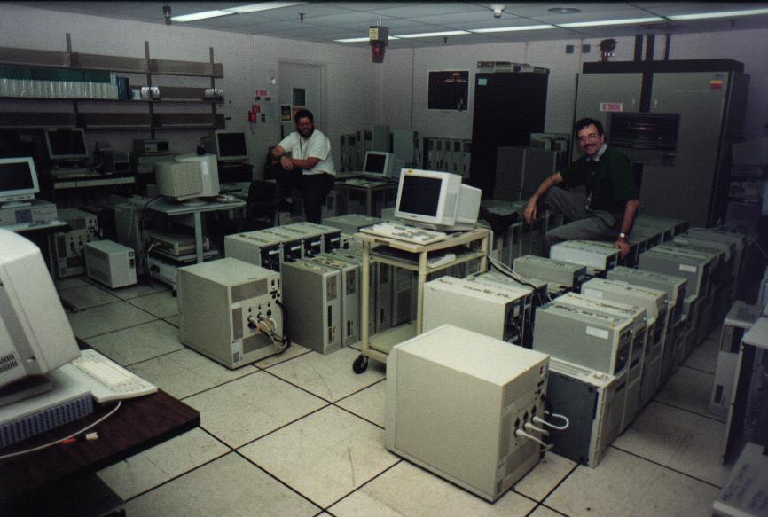
History : Scalable algorithms for Clustering
One of the first Beowulf clusters (ca ‘97)
Data Analytics/Machine Learning
Originally developed in 1996-97 for use on the Stone Soupercomputer, a very early Beowulf cluster (see “The Do-It-Yourself Supercomputer", Scientific American, 265 (2), pp. 72-79, 2001.)

Slide 4
Applications
Vegetation mapping and characterization
Development of ecoregions
Species distribution
ForWarn: Real-time Operational Forest health monitoring
Global Fire Regimes
Climate zone classification
Understand climate regime changes in future
  Under various predicted climate change scenarios

Slide 5
Some Datasets
Problem Config | Data Size | No. of Clusters
GSMNP LiDAR | 900 MB | 30
CMIP3 Climate States | 8 GB | 1000
Phenology 2000 | 25 GB | 1000
CONUS Phenology 2000–2017 | 500 GB | 1000
Preprocessing
Standardized the data set along each dimension
Fairly represent every dimension in the clustering algorithm for high-dimensional datasets.

Slide 6
Parallel k-means Outline
Goal: Divide observations into k clusters
Centralized Master-Worker paradigm
Pick initial centroids
Iterative method
Workers
  Compute distances
  Update centroids and cluster assignments
  Repeat till convergence is achieved
Typical target convergence: < 0.5% changes

Slide 7
BLAS Formulation (Application Phase 1)
Binomial
expansion:
xGER
xGEMM
BLAS Subroutines

Slide 8
Triangular acceleration (Application Phase 2)
C_{new}
Classical k-means performs far more
distance calculations than required!
Use the triangle inequality to eliminate
unnecessary distance computations
If d(C_{last}, C_{new}) ≥ 2d(X_{i}, C_{last})
=> d(X_{i}, C_{new}) ≥ d(X_{i}, C_{last}) without computing
Distance computations can be further reduced by sorting the inter-centroid distances, d(C_{last}, C_{new})
  Evaluate candidate centroids in sorted distance order
  Skip computations once the critical distance, 2d(X_{i}, C_{last}) is surpassed
X_{i}
C_{last}

Slide 9


HPC Platforms

Slide 10

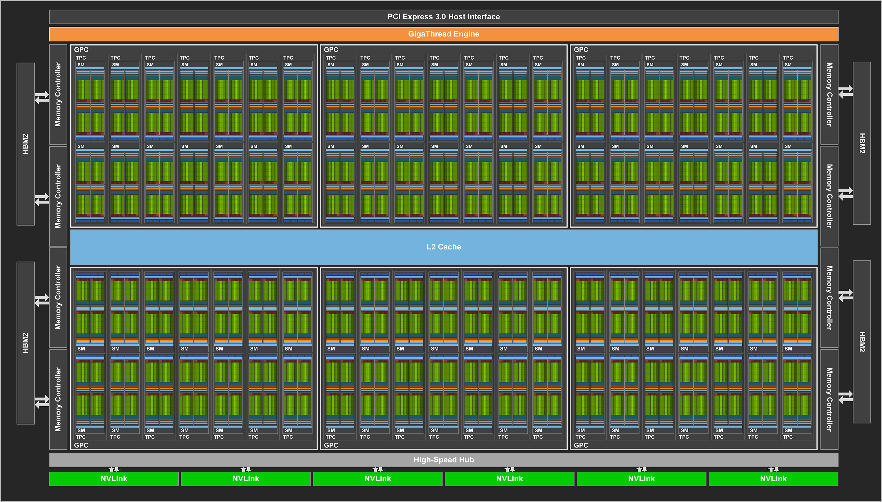
Summit Architecture
~200 PF (143 PF Linpack)
4608 Compute nodes
Each node: 42 TF
Compute
  2 x Power 9 (22 cores)
  0.5 DP TF/s
  6 x Volta V100 GPU (80 SMs – 32 FP64 cores/SM)
  7.8 DP TF/s
Memory/node
  512 GiB DDR4 memory
  96 (6x16) GiB High-bandwidth memory (GPU)
  1.6 TB NVMe

Slide 11
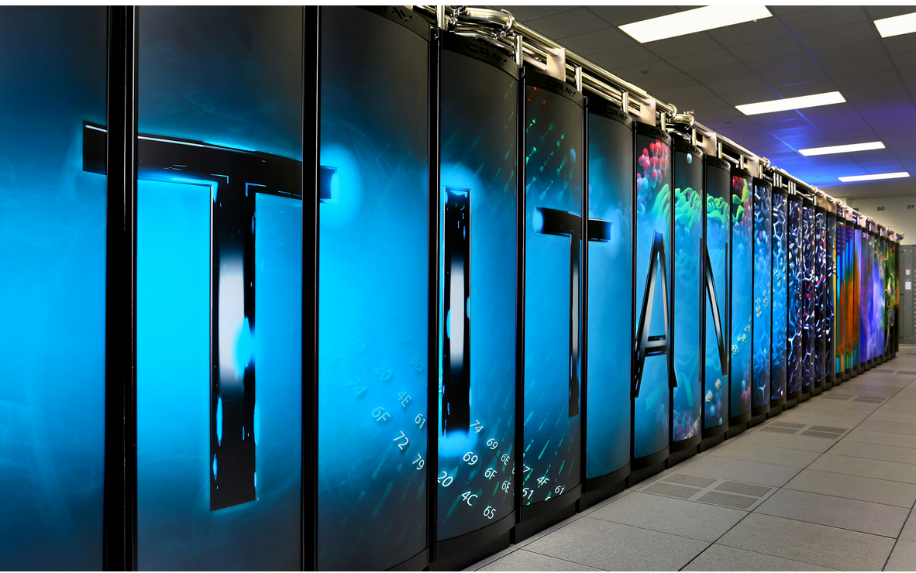
Titan
Cray XK7 system
Each node
  16-core AMD Opteron CPUs
  NVIDIA Kepler K20X GPUs
  32 GB memory
Total of 18,688 nodes
  299,008 CPU cores and 18,688 GPUs.
Software
  CPU (MKL + OpenMP)
  GPU (cuBLAS + OpenACC)
  MPI for communication

Slide 12
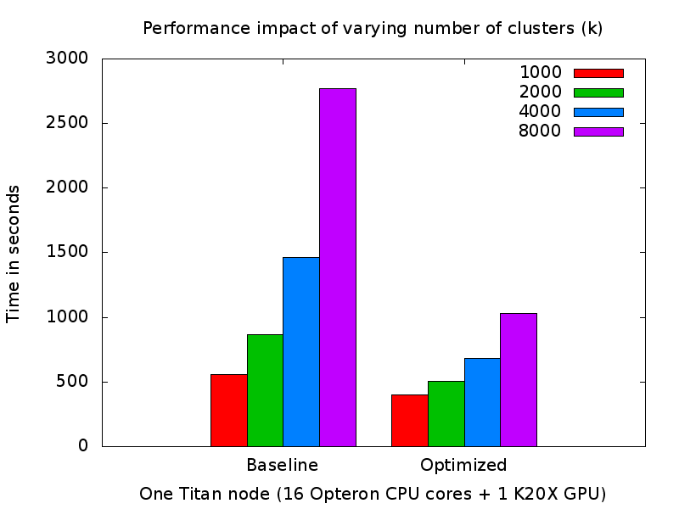
Performance and Scaling
Varying Number of Clusters (k)

Slide 13
Summit: Early Results

Slide 14
Applications

Slide 15
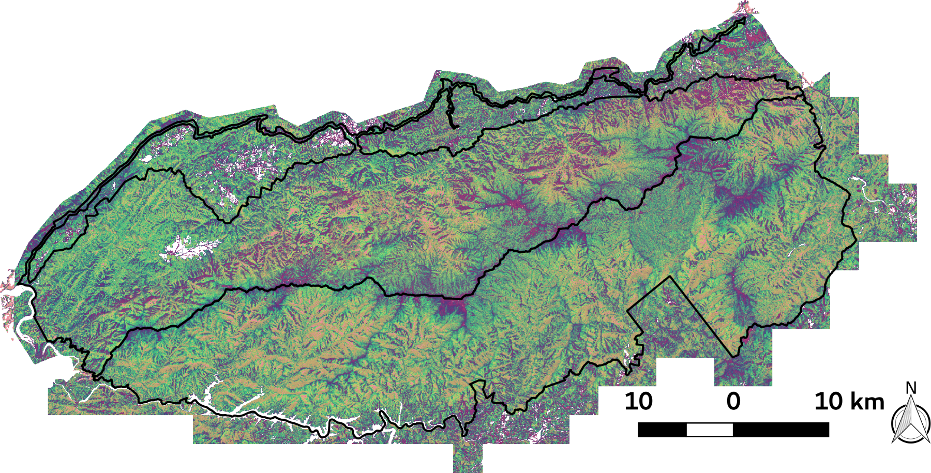
GSMNP: Spatial distribution of the 30 vegetation clusters across the national park

Slide 16
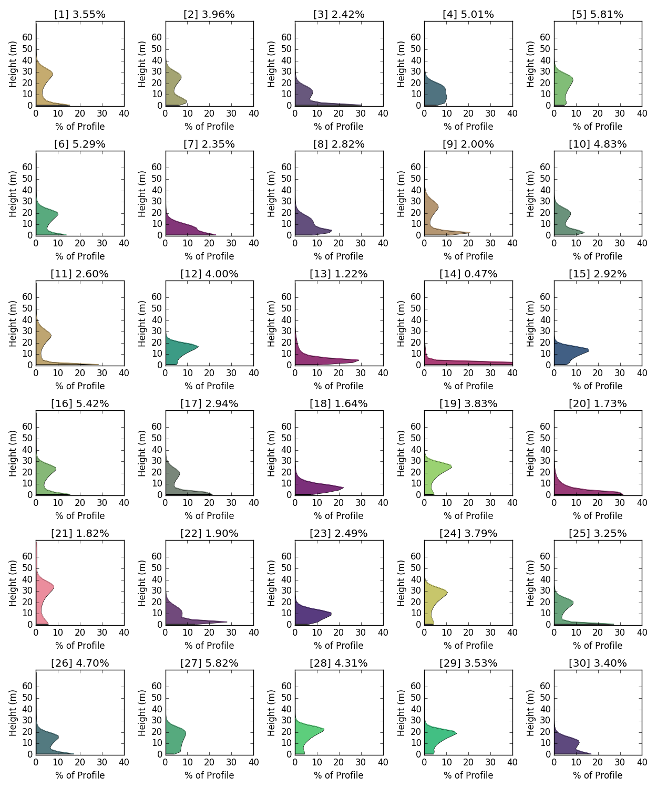
GSMNP: 30 representative vertical structures (cluster centroids) identified
tall forests with low understory vegetation
forests with slightly lower mean height with dense understory vegetation
low height grasslands and heath balds that are small
in area but distinct landscape type

Slide 17
Global Climate Regimes: 1000 clusters
Contemporary using Similarity color scheme

Slide 18
Global Climate Regimes: 1000 clusters
2100 using Similarity color scheme

Slide 19
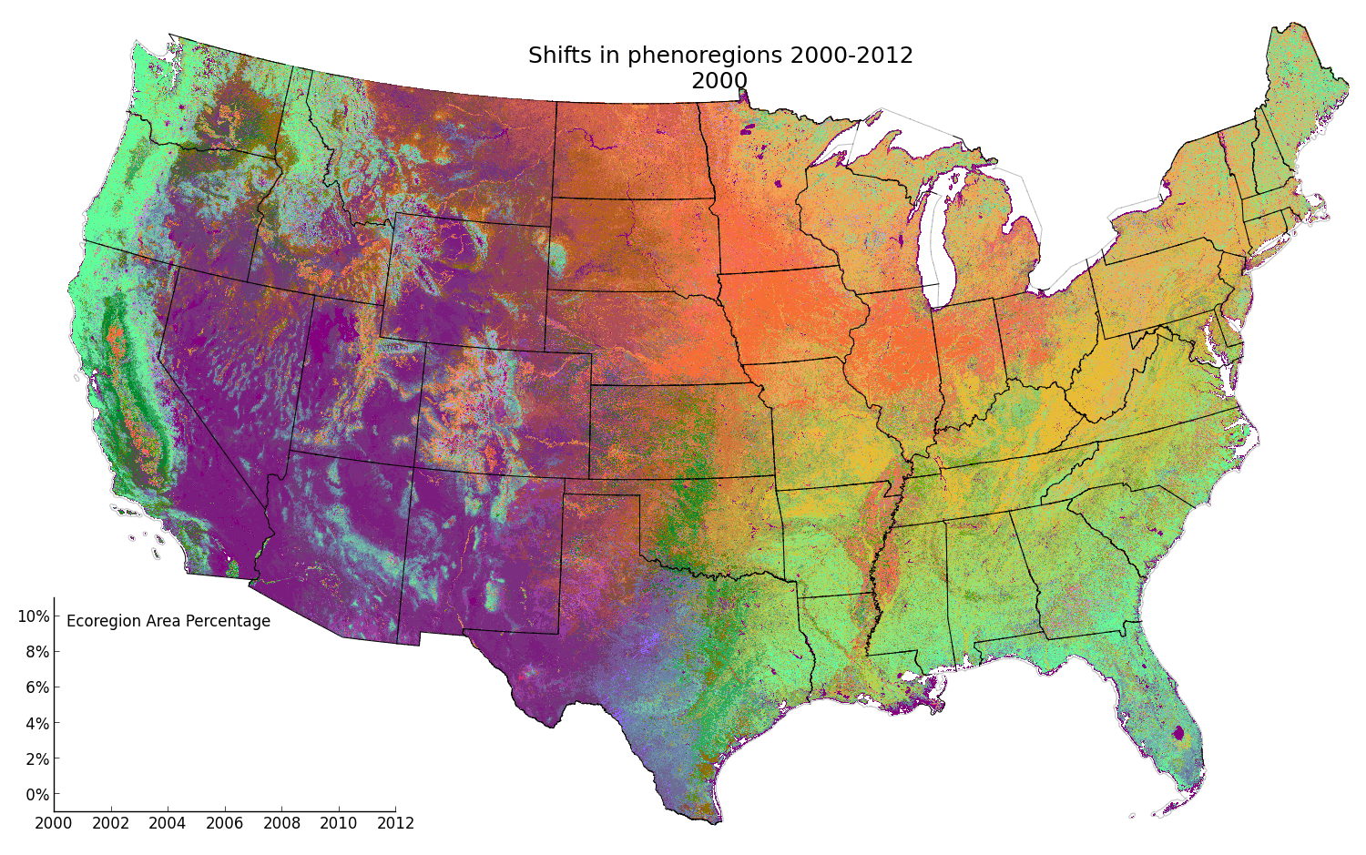
CONUS dynamic phenoregions
Notes:
Midwest – agricultural crop rotation
Changes in deciduous forests in Appalachia
whereas relatively no change in northwest evergreen forests.

Slide 20
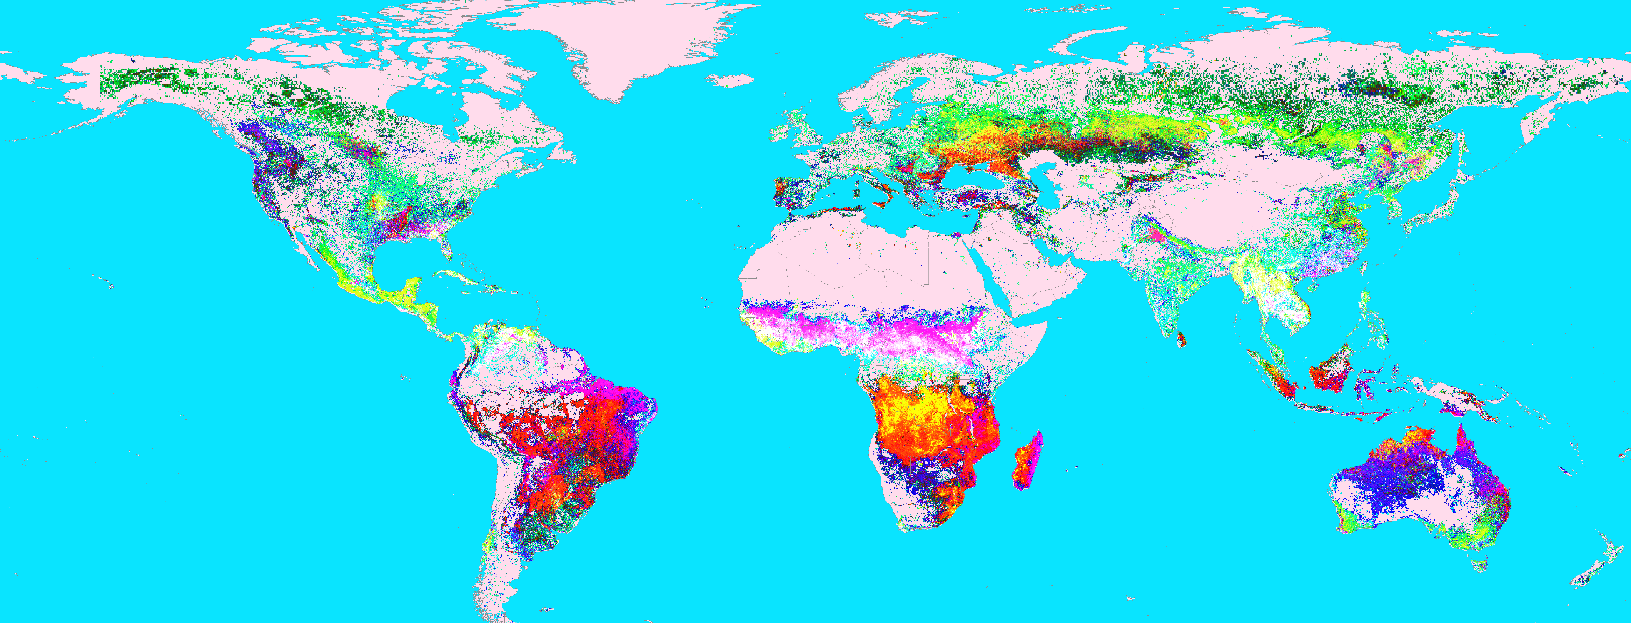
Global Fire Regimes
Notes:
Unsupervised classification of all of historical MODIS Hotspots observations to analyze global fire regimes across the globe. For example 1) Northern high latitude regions exhibit similar fire regimes in terms of their seasonality, intensity and frequency. 2) Crop residue burning in agricultural regions of US-Midwest show similarity to agricultural regions in Punjab region of India. These global understanding would enable better fire management, and sharing of best practices.

Slide 21
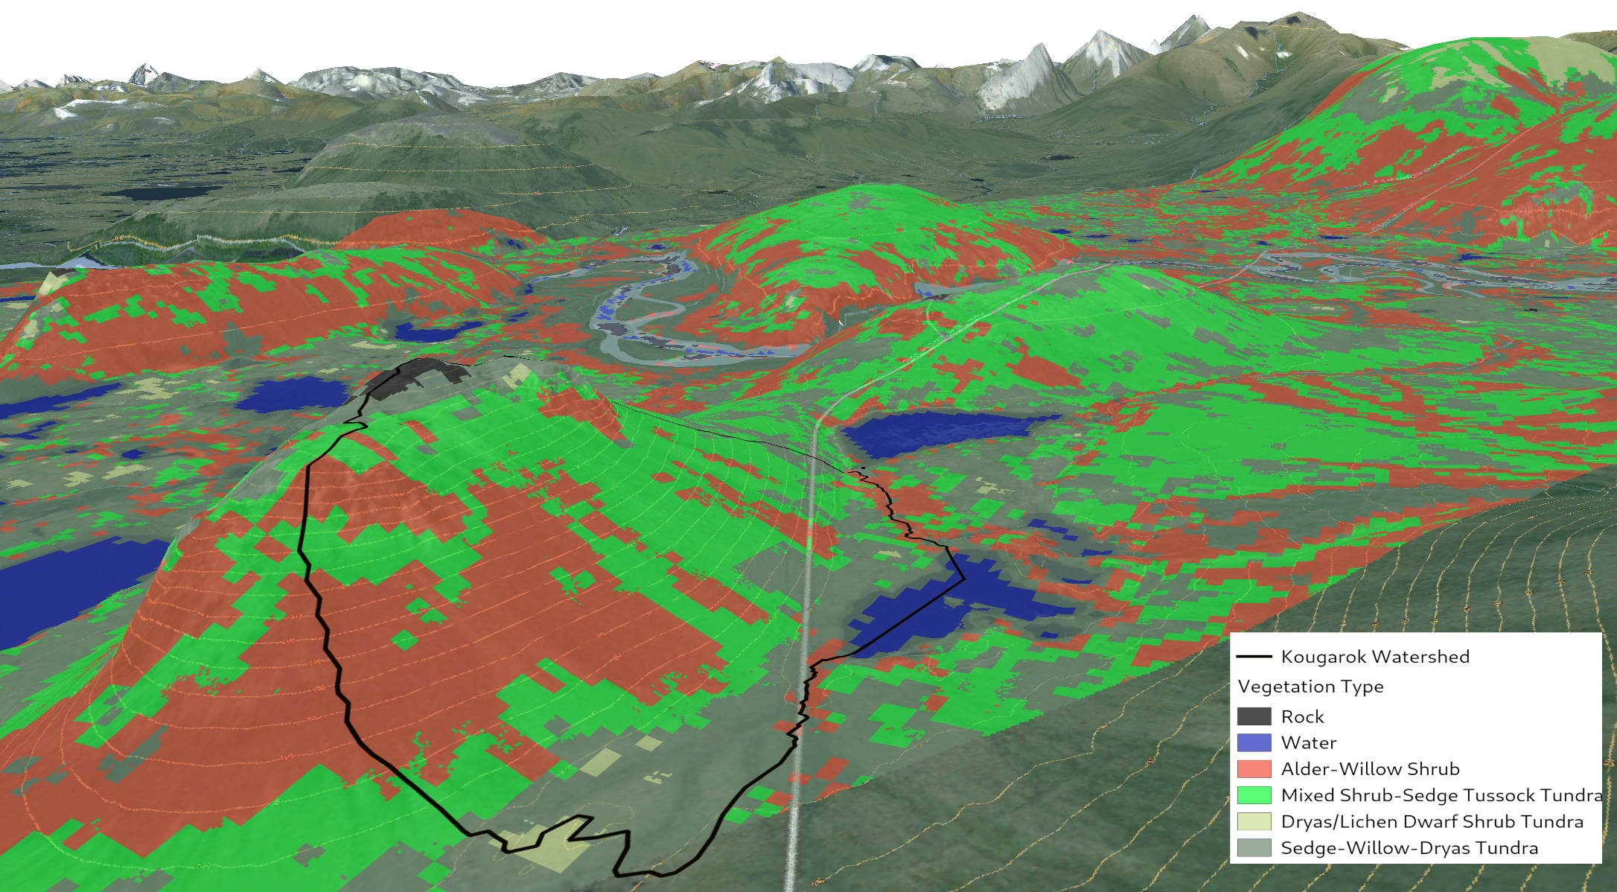
Arctic: High-resolution vegetation mapping
Notes:
Deep neural network based classification of high spectral and spatial resolution remote sensing data from variety of sensor platforms.

Slide 22
Summit : Future Plans
Build upon our hybrid implementation
Utilize non-volatile memory (NVM) technologies
  staging inputs
  storing intermediate data structures
Improve load balancing and utilization of GPUs
Design a decentralized version
  Handle very large data sets - O(10) TB+
Improve integration of different algorithm formulations for better load balancing

Slide 23
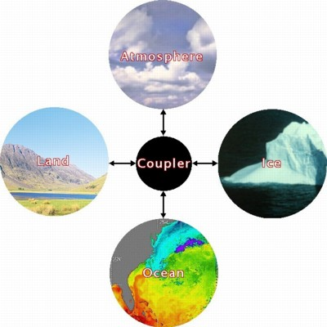
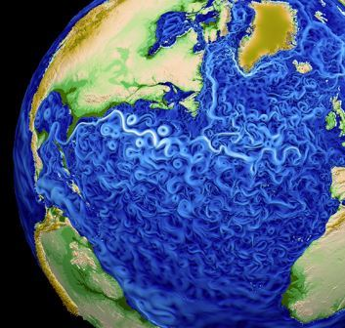
E3SM
Global Earth System Model
Atmosphere, Land, Ocean and Ice component models
8 DOE labs, 12 university subcontracts, 53 FTEs spread over 87 individuals
Development driven by DOE-SC mission interests: Energy/water issues looking out 40 years
Key computational goal: Ensure E3SM effectively utilizes DOE pre-exascale and exascale supercomputers
E3SM is open source / open development
  Website: www.e3sm.org
  Github: https://github.com/E3SM-Project
  DOE Science youtube channel: https://www.youtube.com/channel/UC_rhpi0lBeD1U-6nD2zvlBA
Notes:
23
23

Slide 24

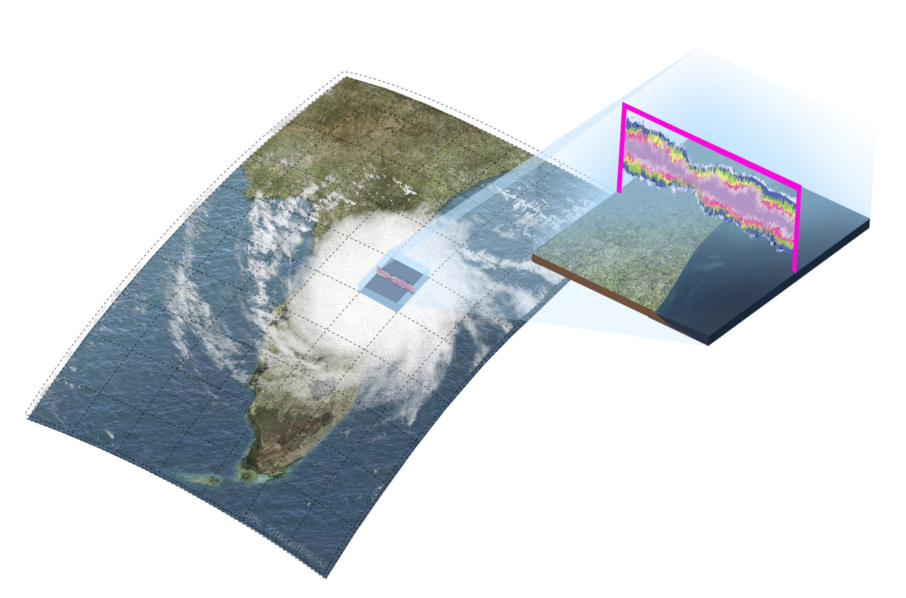
E3SM-MMF Cloud Resolving Climate Model
Goal: Develop capability to assess regional impacts of climate change on the water cycle that directly affect the US economy such as agriculture and energy production.
Multiscale Modeling Framework / Super-Parameterization
Replaces traditional parameterizations with cloud resolving model within each grid cell of global climate model

Slide 25
Co-design
Applications
Software
Hardware
Feedback loop between applications, system s/w
and computer architecture
Application requirements
inform (influence?)
hardware design
Technology choices and constraints guide problem formulation and design of algorithms.

Slide 26






Acknowledgments
U.S. Department of Agriculture, U.S. Forest Service,
Eastern Forest Environmental Threat Assessment Center.
This research used resources of the Oak Ridge Leadership Computing Facility at the Oak Ridge National Laboratory, which is supported by the Office of Science of the U.S. Department of Energy under Contract No. DE-AC05-00OR22725.

Slide 27
Backup

Slide 28
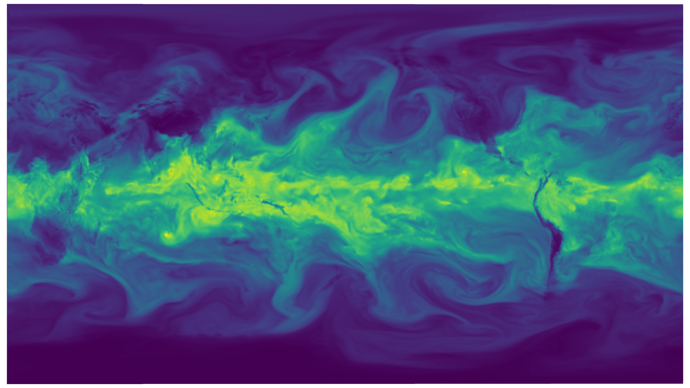
E3SM-MMF Results
Water vapor contours after 40 days of simulation with E3SM-MMF using a 28km global grid and CRMs with 64 internal columns on 1,024 Summit nodes.
Credit: Kyle Pressel

Slide 29
Conclusions
Parallel k-means clustering implementation for hybrid supercomputers
BLAS formulation to accelerate Euclidean distance calculations
Demonstrated up to 2.7x and 2.95x speedup over baseline CPU version in specific problem configurations on Titan and Summit
Demonstrated capability to process large datasets
Several Earth science applications
  Great Smoky Mountains National Park: identification of vegetation structure
  Global Climate Regimes: understanding global patterns of climate, vegetation and terrestrial ecology

Slide 30
Datasets
Great Smoky Mountains National Park (GSMNP)
Airborne multiple return Light Detection and Ranging (LiDAR) data
  Vertical canopy structure of the vegetation (74 dimensions)
  30 m × 30 m spatial resolution horizontal grid
  1 m vertical resolution to identify vegetation height from the ground surface
Global Climate Regimes
Bioclimatic (BioClim) data for the contemporary period (17 dimensions)
Climate models from IPCC Third Assessment Report (CMIP3) – Parallel Climate Model (PCM) and HadCM3 model
Two different emissions scenarios:
  B1 (lower emissions), A1FI (high emissions)

Slide 31
Global Climate Regimes: Variables

Slide 32
Summit Early Science Results
Initial porting to Summit
Performance Analysis and optimization
Process large datasets – infeasible on Titan
Problem Config | Data Size | No. of Clusters | Nodes | CPU (avg cluster time/iter) | GPU (avg cluster time /iter) | Speedup
Phenology 2000 | 25 GB | 1000 | 1 | 22.69 s | 8.47 s | 2.67
CONUS Phenology 2000–2015 | 395 GB | 1000 | 100 | 10.60 s | 3.59 s | 2.95

Slide 33
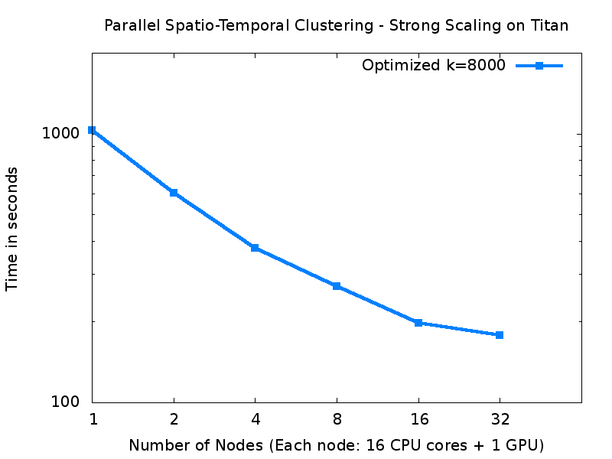
Performance: Strong Scaling

Slide 34
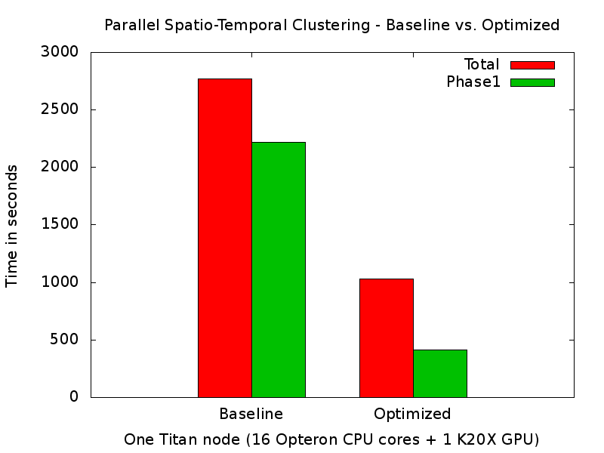
Performance Comparison

